Slide 1

Cloud Computing
Mr Butler

Slide 2

Learning Intentions
Explain what is meant by cloud computing
Explain the terms virtualisation, hosted instances, hosted solutions and clustering;
describe how cloud computing provides services, such as: data storage; Email virtualised software Backup remotely hosted applications
Evaluate the use of cloud computing in terms of business benefits and security issues

Slide 3

What is Cloud Computing?
The organisation’s data is managed and processed by a third party, such as a computer services company.
The data is stored on a global network of servers or data farms on the Internet.
Its aim is to provide services normally provided by a network.
A data farm, or server farm, is a central computer centre which consists of a large number of linked file servers. It’s used to host the services they provide for other organisations who can access these services from any suitable computer which has an internet connection.

Slide 4

Where actually is the cloud?
Data used is not necessarily stored locally and the users of cloud computing services are rarely aware of the location of the software they are using or the server used to store their data.
Any public cloud like this one may have a series of data centres at different physical locations.
Each geographical location could have many servers, computers storage devices and other components used to support the services being provided by the Cloud Service Provider.

Slide 5
Virtualisation
Virtual Servers form the foundation of cloud platforms. The process of virtualisation allows ‘virtual servers’ to run on a physical server platform.
Virtualisation software separates the physical infrastructures to create dedicated resources.
  It makes it possible to run multiple operating systems and applications on the same server at the same time by making servers.
  Virtualisation manipulates the hardware used to provide cloud computing as a service to the client users.
A number of virtual servers each running on a physical server platform Separates the physical infrastructures to create dedicated resources running multiple OS and applications on the same server.

Slide 6

Virtualisation
You may have found that programs work differently on different computers. For example, a program written to work on a gaming console like a Playstation may not run at all on your desktop computer.
To solve this problem, you could:
  Buy a new computer that will run the software you have
  Buy a version of the software that will run on your computer
Both of these are expensive and inconvenient solutions.
Another solution is to get your computer to create a software copy of the computer you need, and then run your program inside that. This software copy of a computer is called a virtual machine (VM). It is a 'computer inside a computer'.
The process of creating a VM is called 'virtualisation'. There can be many VMs running on a single host.

Slide 7
Cloud Instances and Clustering
A cloud instance can be thought of as a location of physical memory on a cloud server which has been allocated to a particular client or owner
  i.e. it is a block of memory which acts as a virtual server for that client and it will have its own allocation of processing power, storage and other components.
Each server will serve multiple clients. This makes it possible to allocate additional capacity to clients when their usage spikes and resource demands increase.
  Each of the elements in an instance definition is dynamic and can therefore be amended or adjusted.
  Each instance provides a virtual environment which can be used by the client for the processing of their cloud based task or application.
  For the end user there is no need to give consideration to how many servers or other resources are being applied to their application, their location is immaterial and the dynamic nature of cloud instance computing means resources can be reassigned as needed without the client experiencing any downtime.
  If the end user wants to access a particular application or service they create an instance in the cloud for the duration of time they are using that application.
While a cloud instance is based upon the dynamic sharing of resources each time a client needs to access a hosted service, with a hosted solution any hardware and software made available to a client is reserved for the servicing of that individual client’s needs and no one else.
  That one client pays for all of the resources made available to them regardless of whether they are used or not. In a situation where a client’s usage exceeds the capacity allocated to them then additional investment in resources must be made by the client.

Slide 8

Cloud Instances
A cloud instance, or hosted Instance, is a location of physical memory on a cloud server allocated to a particular client.
A hosted instance is a virtual computing environment provided by a third-party service, offering remote access to hardware and software resources hosted on the provider's servers.
Users can configure, manage, and scale these instances based on their needs, eliminating the need for physical infrastructure maintenance.

Slide 9
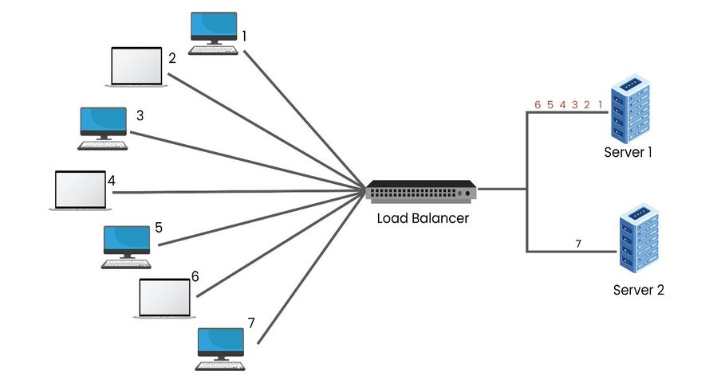
Clusters
This is the cloud service
Each data centre will hold clusters of dedicated hardware that will be used to offer clients specialized services and processes.
Cloud computing makes use of the idea of virtual clusters, which are created, for instance, when a virtual machine created to serve the needs of a cloud instance configures the network's resources to satisfy the needs of the client.
Clusters are groups of dedicated hardware and are hosted at each data centre to provide specialised services/processes for clients.
Notes:
Cluster computing depicts a system that consists of two or more computers or systems, often known as nodes. These nodes work together for executing applications and performing other tasks.

Slide 10




Provision of cloud computing services
Clients may have access to a variety of cloud computing services. The customer can be given the data, software, and virtual platform they require to meet their application demands by using cloud-based technology, such as that which was just stated.
In the majority of cases, users need a secure client login to access the services they are using.
Clients and cloud service providers typically use encrypted connections to transfer data.

Slide 11
Services Available
Data Storage
Data saving on an off-site system offered by a third party is referred to as cloud storage.
Email
Web based email services allow users to access their email from the cloud using any browser or hardware platform
Virtualised Software
Users can now access a wide variety of applications online. Popular programs like MS Office and classic desktop programs like financial apps have partially moved online.
Backup
Clients can store their data on the internet using a storage service provider rather than storing data locally on a physical hard drive or other device.
Remotely Hosted Applications
These enable clients to access their business applications from any location in the world where they have access to technology and a connection to the internet.
The user has the benefit of being able to share and access their data files from anyplace they have access to an internet connection in addition to being able to access the software from any location.
Data is saved to a distant database that is accessed through the internet rather than being kept on the hard drive of your computer or another local storage device.
By doing this, users can access application hosting without worrying about how much space is used on their own personal devices. Software is offered without the user having to think about installation, and updates are made available right away.
The essential software and data can be kept on a remote server and accessible as an instance utilizing virtual desktops from any location.
The staff of the organization can access apps and data in several concurrent sessions thanks to remote hosting of applications in this way.
Emails sent and received via the client's account are stored on the service provider's server rather than being stored on the user's own computer
Data can be stored to the cloud on a scheduled basis or cloud syncing can be used to ensure files will automatically be backed up any time changes are made to them

Slide 12


Benefits of Cloud Computing
Providers can respond to changes in user requirements more quickly.
Increased security and system reliability as the supplier only needs to maintain one system. Since all users are accessing the same software system, cross-compatibility issues are no longer an issue.
Collaboration using a wide variety of devices from a wide variety of locations can be supported.
Cross compatibility, with updates made available for all users.
Lower expenses because the customer won't have to think about the cost of obtaining and configuring hardware and software to fulfil their demands
More flexibility in terms of work arrangements. The majority of cloud computing services are offered on demand, making it possible to accommodate even significant variations in the demand for computing resources (sometimes at a fee).
Enhanced reliability - Because data may be duplicated across several redundant sites on the network of the cloud provider, cloud computing enables data backup, disaster recovery, and business continuity easier and less expensive.

Slide 13

Drawbacks of Cloud Computing
Because the service provider handles all upgrades, backups, restorations, and security management, you can’t trust them to take care of your data and any accompanying apps. – security concerns
Where vast amounts of data are held by many different users, frequently on the same cloud server, cyber attacks are difficult to combat and common.
Problems can also arise from insider threats. It's common for employees who have access to your cloud data to go undiscovered. In addition to having access to the data held on your organization's virtual machine, an intruder might possibly destroy the entire cloud environment that is home to your data or application.
Many people are nevertheless concerned about the loss of confidentiality of data that government surveillance programs are legally allowed to access.
Organizations that rely on cloud-based services still struggle with legal liability due to uncertainty over who will bear responsibility in the event of a data breach!

Slide 14

Discuss the use of Cloud computing for a business
[6]

Slide 15
Discuss the use of Cloud computing for a business
Definition:
  An organisation’s data is managed by a third party. The data is stored on a global network of servers/data farms on the Internet.
Benefits
  Resource Utilization: Virtualization allows efficient use of physical resources, such as CPU, memory, and storage, by running multiple virtual machines (VMs) on a single physical server. This maximizes resource utilization, reducing hardware and power costs.
  Isolation and Security: Virtualization provides strong isolation between VMs, enhancing security. If one VM is compromised, it doesn't affect others. VMs can be easily backed up, restored, or moved, improving disaster recovery and minimizing data loss.
  Flexibility and Scalability: Virtualization enables easy scalability by adding or removing VMs as needed, adapting to changing workloads. This flexibility accelerates deployment of new applications and services, reducing time-to-market.
  Server Consolidation: Virtualization allows consolidation of multiple underutilized physical servers into fewer, highly utilized ones. This reduces the data centre footprint, leading to lower cooling and space requirements, which in turn reduces operational costs.
Drawbacks
  Resource Overhead: Virtualization introduces overhead in terms of system resources. The hypervisor, which manages multiple VMs, consumes CPU cycles and memory, potentially impacting overall system performance and increasing hardware requirements.
  Complexity: Managing a virtualized environment can be complex. The setup and maintenance of the hypervisor, VMs, and networking configurations require specialized skills. This complexity can lead to increased management costs.
  Security Concerns: While virtualization enhances isolation, vulnerabilities in the hypervisor or misconfigurations can create security risks. An attack on the hypervisor could compromise multiple VMs, necessitating robust security measures.
  Licensing and Cost: Some software licenses may not be well-suited for virtualized environments. Licensing costs can increase if not properly managed. Additionally, while virtualization can lead to cost savings, initial investments in hardware, training, and management tools can be significant.
[6]

Slide 16

Activity
Define cloud computing in your own words.
List three key benefits of using cloud computing.
Explain the difference between a public cloud and a private cloud.
What is virtualization, and how does it relate to cloud computing?
Give an example of a popular cloud computing service and describe how it is used.
Discuss the concept of "elasticity" in the context of cloud computing.
Name two well-known cloud service providers and briefly describe their specialties.
What is the "pay-as-you-go" model in cloud computing, and why is it advantageous?
Describe the concept of "multi-tenancy" in cloud computing.
Explain the term "load balancing" as it pertains to cloud infrastructure.

